Slide 1




Age of Metamorphism Documented by Monazite in the Orocopia Schist at Cemetery Ridge, AZ
Zoe Durica
Authors: Suzanne Affinati, Thomas Hoisch, Gordon Haxel, Gabe Epstein, Carl Jacobson

Slide 2
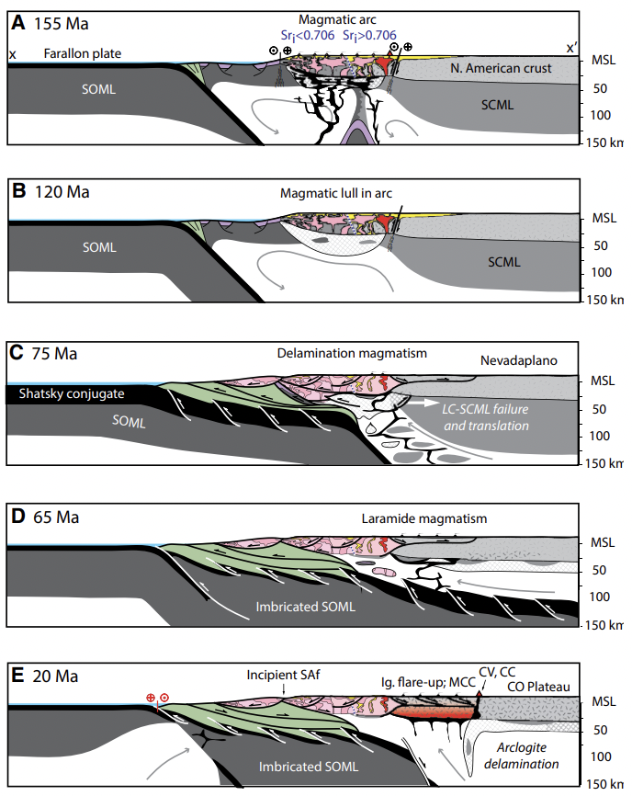
Tectonic Context
Goals of project:
Observe chemical changes in monazite, particularly in fluid-mobile elements (LREE and Sr) during crystallization
Analyze isotopic ages from the monazite to interpret the age of fluid-driven metamorphism
Chapman et al. 2019
Notes:
A &B show normal subduction zone
C- shallow subduction
Shallow subduction effects the geologic processes in the crust
Likely introduces fluids—investigating changes from the fluids and understand metamorphic conditions

Slide 3
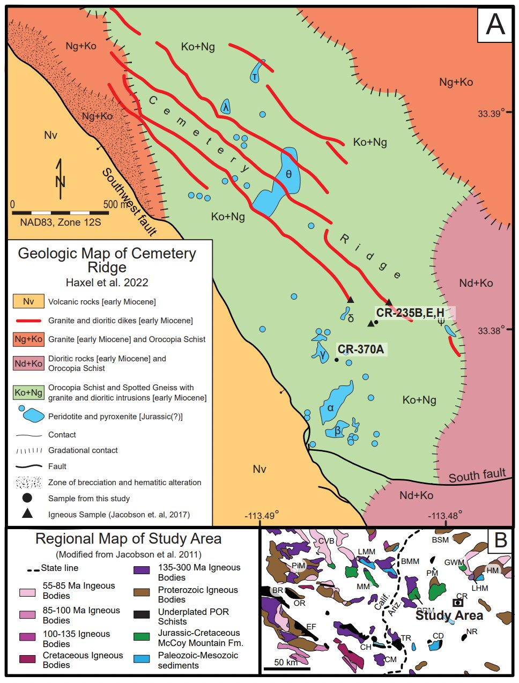
Sample Locations
Cemetery Ridge- lower continental crust
  Shows evidence of unusually high metamorphic grade and fluid-driven metamorphism
Focused on Orocopia Schist
  Metamorphosed oceanic trench sediments
  Zircon ages (73-70 Ma), (Haxel et al. 2023).
  Miocene granite zircon ages (22-20 Ma), (Jacobson et al. 2017)
Notes:
Cemetery Ridge is an exposure of lower continental crust that shows evidence of unusually high metamorphic grade and fluid-driven metamorphism
The Orocopia Schist is interpreted to be metamorphosed oceanic trench sediments that were carried beneath the continental crust during low-angle subduction in the Late Cretaceous period.
Metamorphism has been dated by U-Pb zircon analyses to around 73-70 Ma, with some areas being potentially older or younger to extend from 70-65 Ma (Haxel et al, 2023).
The exposure of the Orocopia Schist is surrounded and intruded by Miocene volcanic and intrusive rocks, which have been dated by U-Pb zircon analyses to 22-20 Ma.

Slide 4
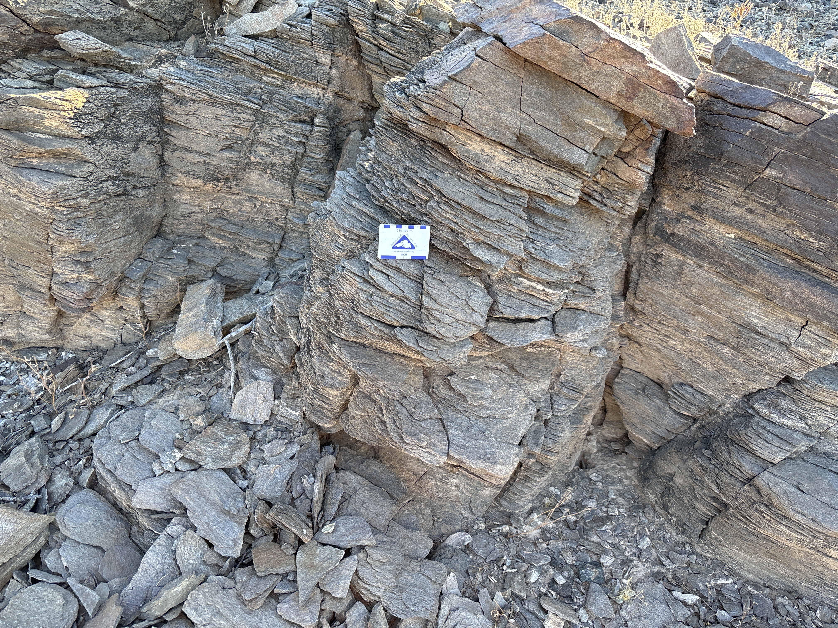
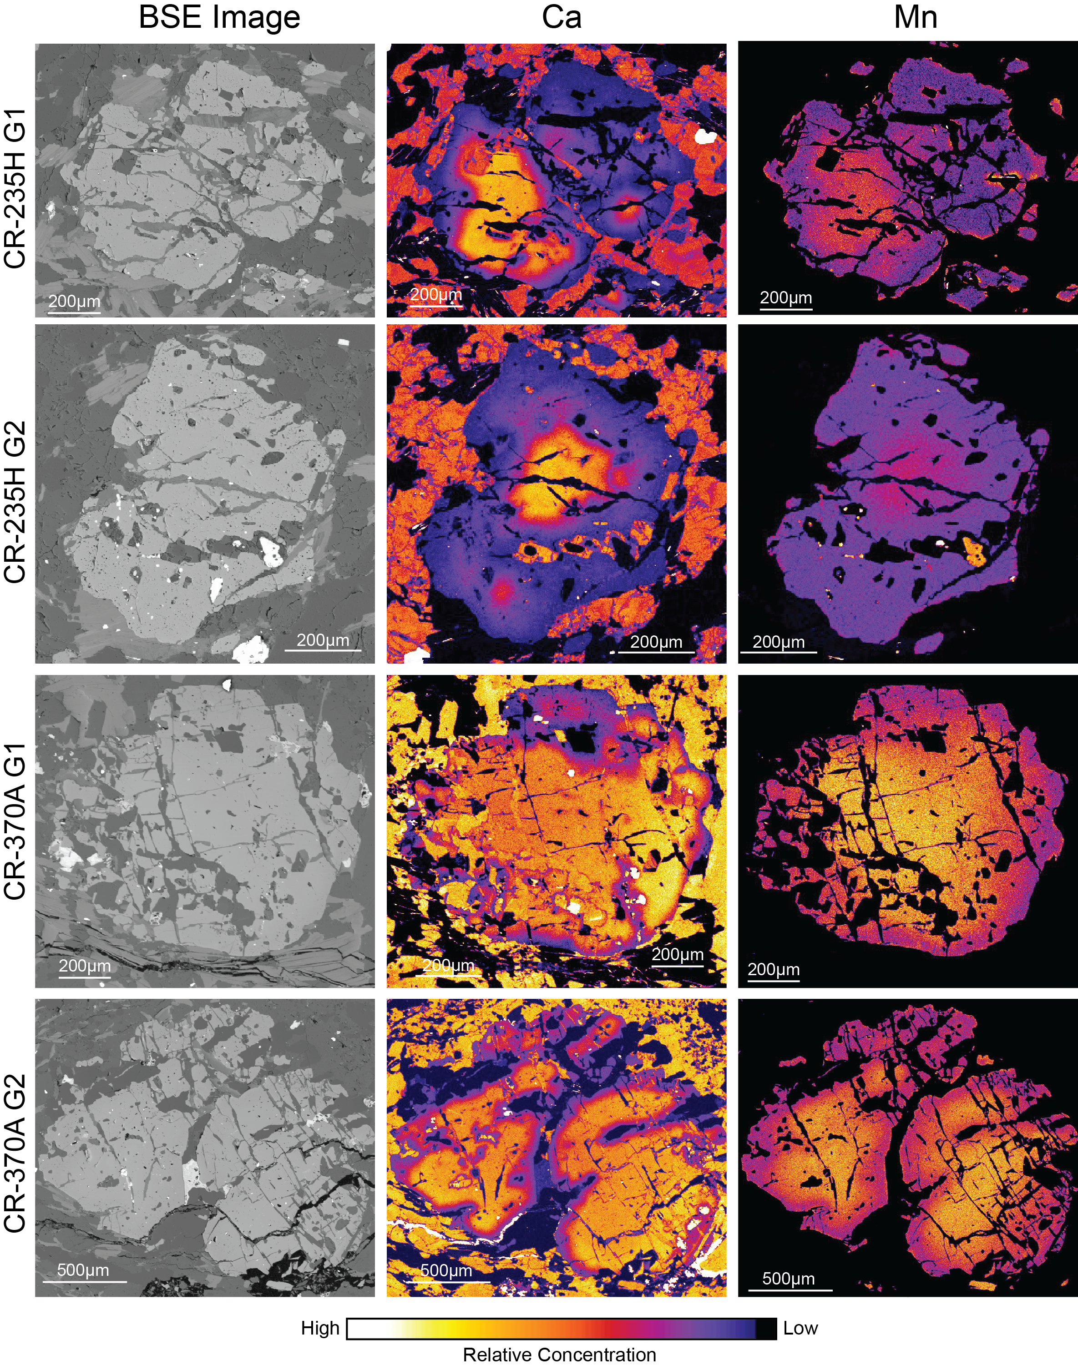
Sample Descriptions
Notes:
Outcrop- quartzofeldspathic schist (mostly quartz and feldspars(plag) w/ garnet)
Foliation (schistosity)
Garnets- microprobe images
Shows zoning

Slide 5
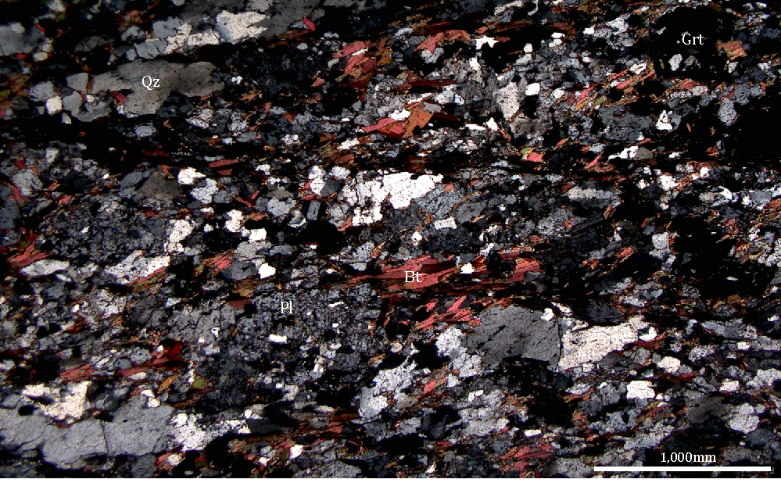
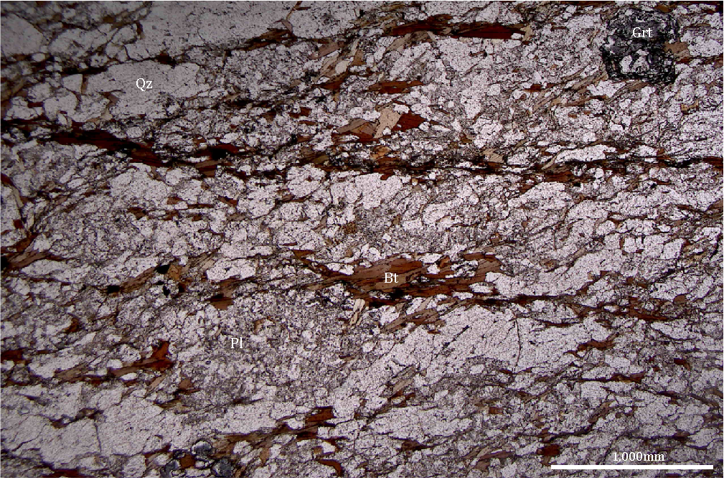
Sample Descriptions
Photomicrographs:
Right: XPL 4x
Left: PPL 4x

Slide 6
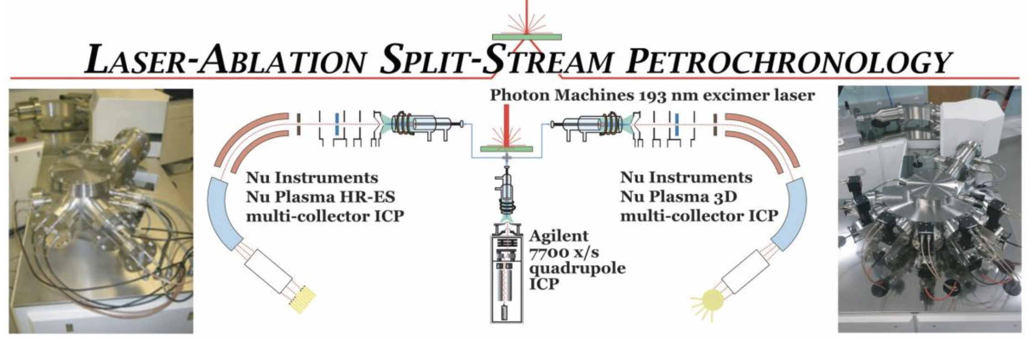
Methods
Backscattered secondary electron (BSE) images on a scanning electron microscope (SEM) at Northern Arizona University
The Energy Dispersive x-ray (EDS) attachment of the SEM
The monazite grains were analyzed using a laser ablation split-stream (LASS) system at the University of California Santa Barbara. (8micron spots)
  ICP-MS multi-collector collects isotope analysis
  Quadrupole mass spectrometer collects trace elements data.
Notes:
Backscattered secondary electron (BSE) images were taken on a scanning electron microscope (SEM) at Northern Arizona University for each thin section to create a montage of the entire section.
The Energy Dispersive x-ray (EDS) attachment of the SEM, mineral grains were targeted to identify monazite grains that could be analyzed.

Slide 7
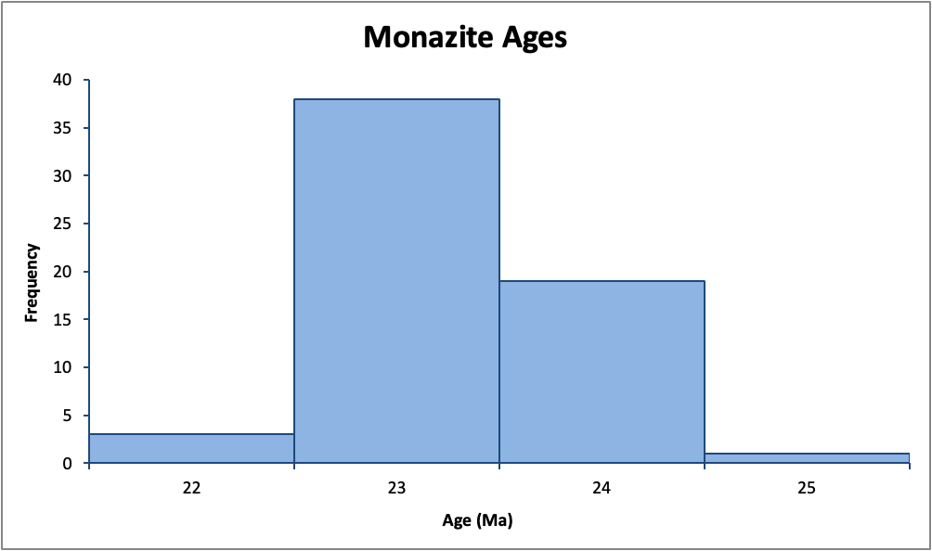
Results
Analysis from 4 different samples, 17 spots
Notes:
Sigma error- 1Ma
Goal was to collect laramide ages- results were Miocene

Slide 8
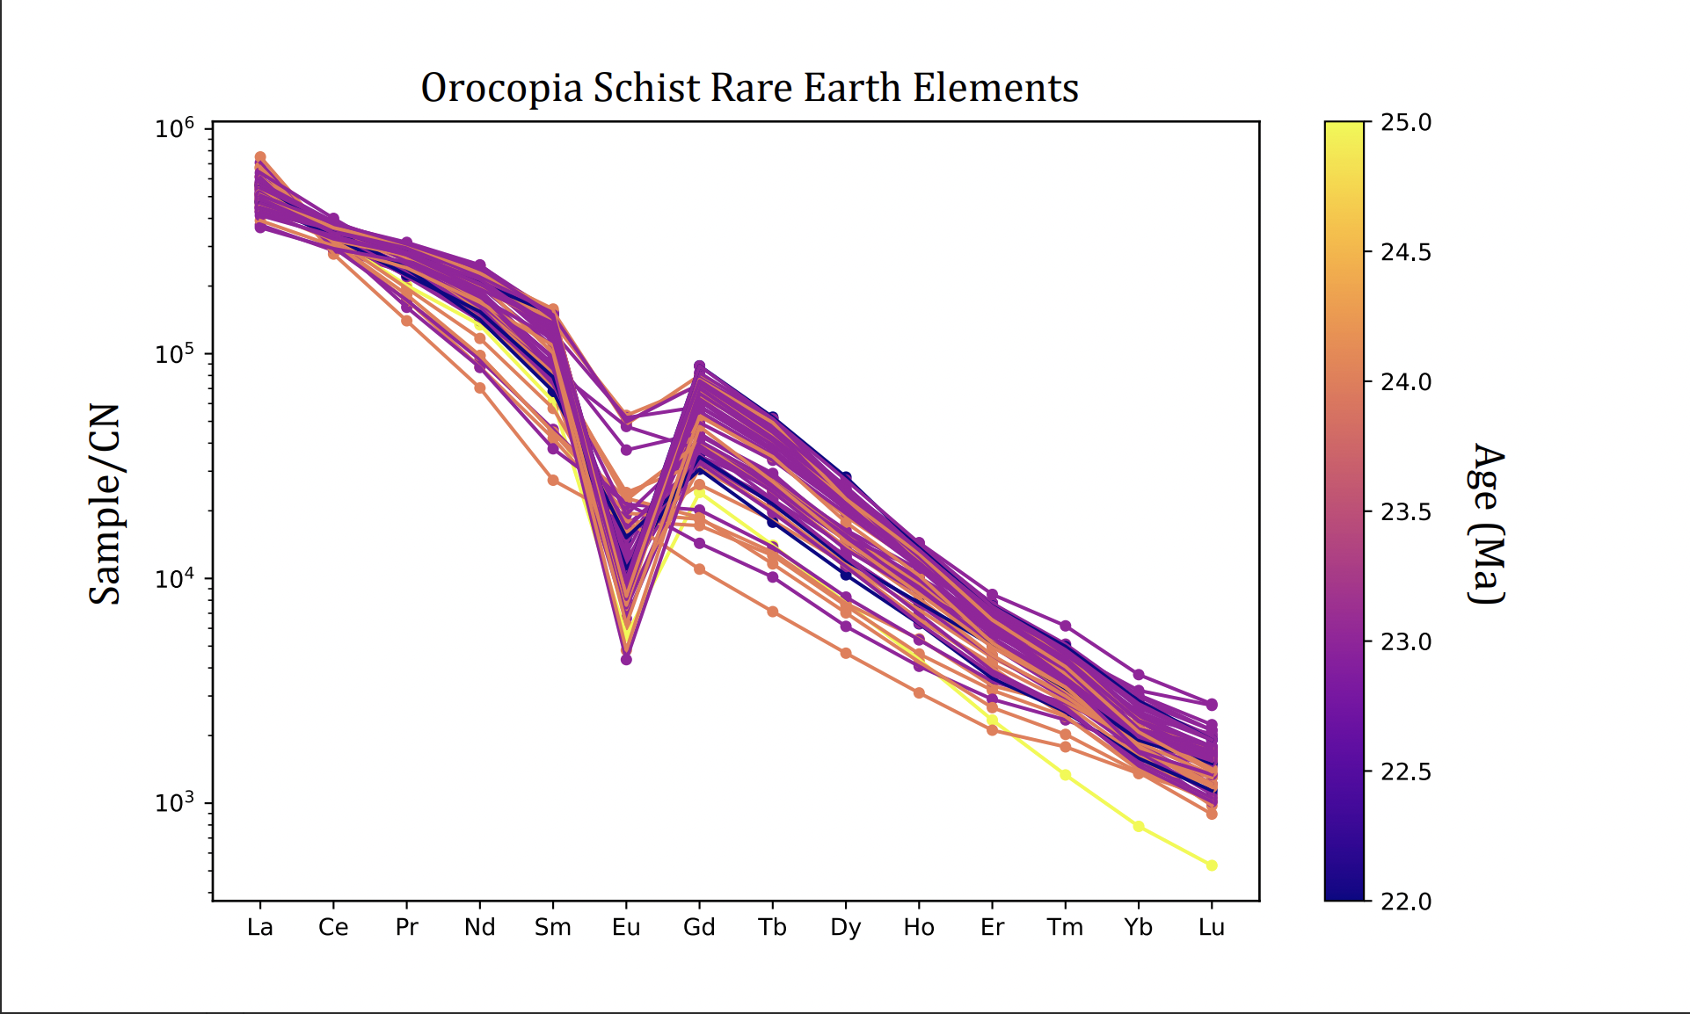
Results
Notes:
Goals was to see changes with age but relatively consistent
Normalization method compares data to chondrites
Samples are all enriched in REE (more LREE than HREE) compared to chondrites
Negative Eu anomaly usually relates to plag crystallizing, interpretation- fluids not breaking down plag, plag holds onto Eu
Eu is 3+/2+ element, Eu can substitute into 2+ plag

Slide 9
Conclusions
Monazite crystallized in Orocopia Schist in the Miocene.
REE plots suggests the metasomatic event that crystallized monazite came from source where plagioclase had already crystallized
Ages of monazite are the same as the ages of the granites, which suggests a connection
Tectonic context:
Not related to onset of Laramide subduction but may be related to increased volcanism associated with slab roll-back around 20 Ma (E)
Chapman et al. 2019
Notes:
Roll-back- normal subduction to flat-slab to delamination (lower plate is stuck to upper and "falls off" and "rolls back" toward trench
Removal of plate reintroduces mantle processes

Slide 10
Thank you

